Slide 1
Starter: What are some natural disasters That humans have to prepare for?

Slide 2
Time to fix Mrs. Freeman’s mistake…. ☺

Slide 3
Current Event Review
Pick something that happened THAT WEEK
Look at two sources
Summary
Differences
Relate to Class
Opinion

Slide 4
Current Event Review
We will have someone present their current event EVERY Thursday or Friday we have class
Extra Credit opportunity the sooner you sign up and present
15 points for Term 1
10 points for Term 2
5 points for Term 3
I will let you know a couple of days before that you are presenting
The entire presentation is worth 100 points

Slide 5
Creation of the Earth and Pangaea

Slide 6
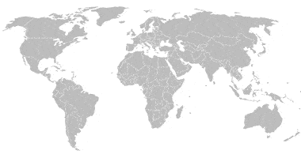
Where do you think the continents would fit together?

Slide 7
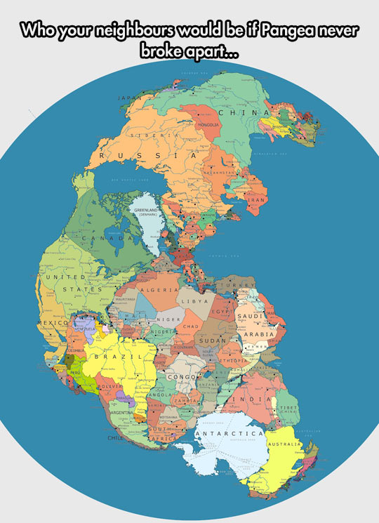

Slide 8
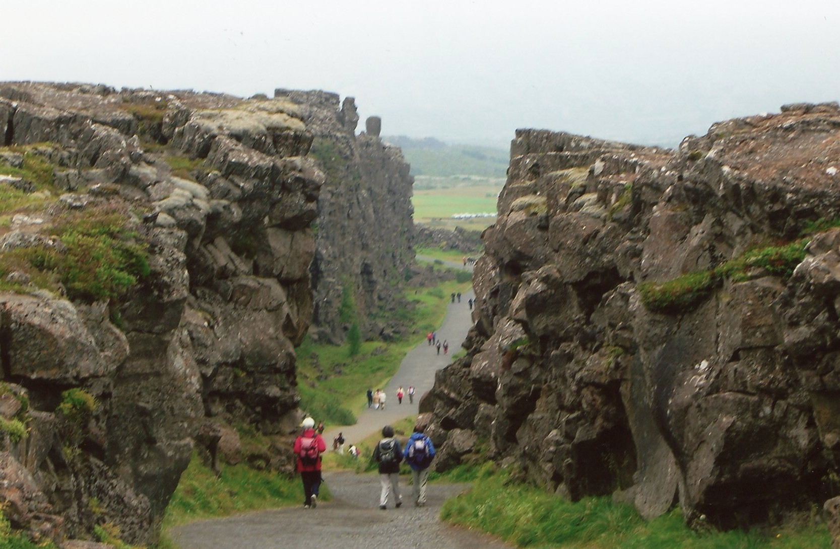
Fault lines

Slide 9
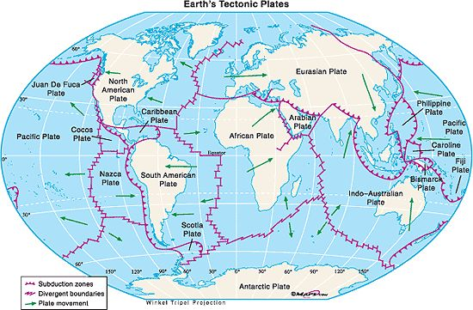

Slide 10
Maps in the textbook

Slide 11
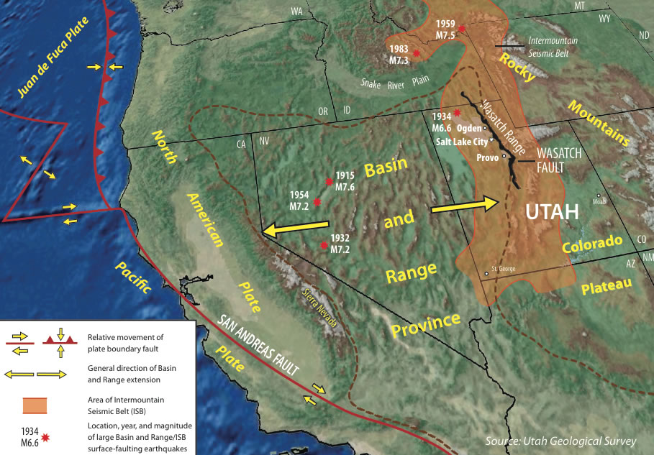

Slide 12
What do we need to prepare for?

Slide 13
Family Plan
We are a family preparing for a disaster
Each group will be responsible for one preparedness category
You will come up with 4+ things you can do to prepare NOW and a plan of 4+ you would do in the disaster

