Slide 1
MUST SEE THIS

Slide 2
Historical Thinking Skills Page 8 in your packet

Slide 3
What does it mean to be a hero?

Slide 4
What is History?
Think about the Lewis Mystery….
History is an account of the Past
Accounts differ depending on one’s perspective
We use evidence to construct accounts of the past
Any single piece of evidence is insufficient to build a realistic account

Slide 5
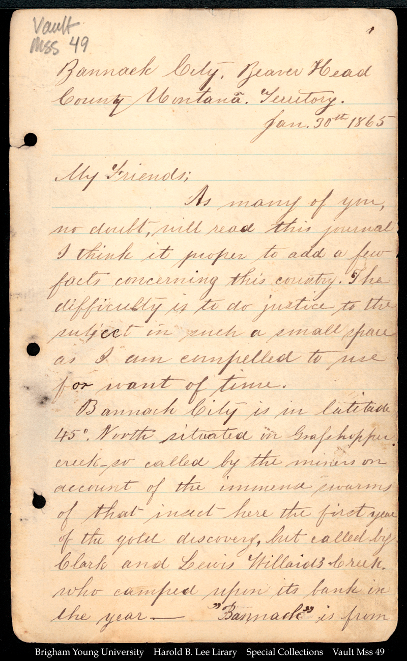
Types of Evidence: Accounts
Accounts
An account is a report or a description that a person makes about an event or experience
Example: If I wrote in my journal about class today
Two Types of Accounts
Primary: accounts that were made at the time
Secondary: accounts that were created later
What problems might you have with an account?

Slide 6
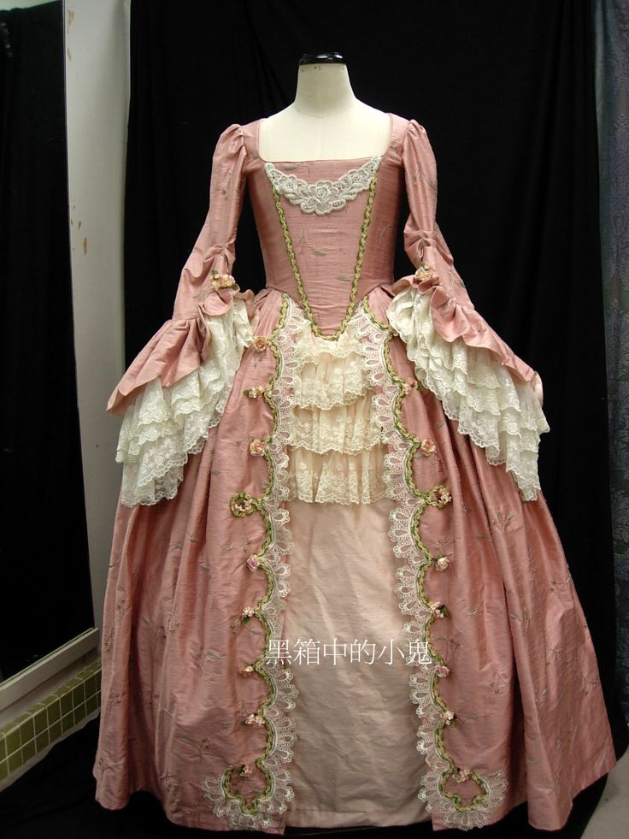
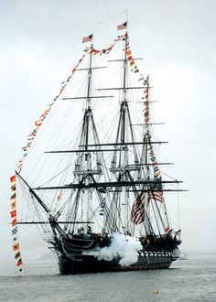
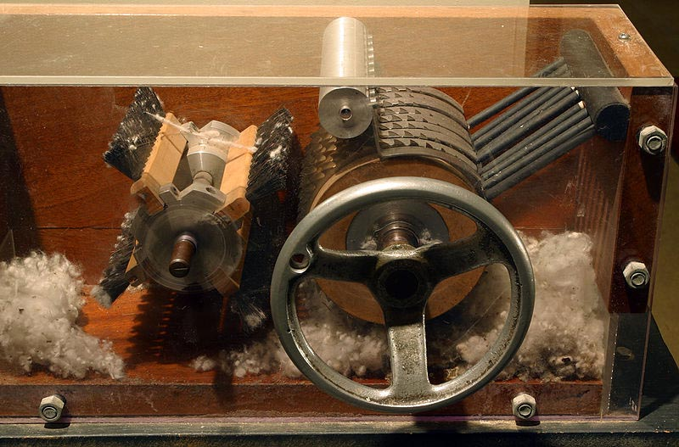
Types of Evidence: Traces
Traces
Surviving evidence from the time period
What problems might you have with a Trace?

Slide 7
When reading accounts, focus on…
Sourcing: Looking at who wrote the document and thinking about why they wrote it (You do this before you read the document
Questions:
What is the author’s perspective?
Why was it written?
Who are they writing for?
Is it reliable? Why? Why not?

Slide 8
When reading accounts, focus on…
Contextualization: locate a document in time and place and to understand how these factors shape its content
Questions:
When and where was the document created?
What was the same then?
How might the circumstances in which the document was created affect its content?

Slide 9
When reading accounts, focus on…
Corroboration: Comparing multiple sources and seeing what is similar and different.
Questions: What do other documents say?
Do the documents agree? If not, why?
What are other possible documents?
What documents are the most reliable?

Slide 10
When reading accounts, focus on…
Close Reading: Analyzing what is written in the source.
Questions:
What claims does the author make?
What evidence does the author use?
What language (words, phrases, images, symbols) does the author use to persuade the document’s audience?
How does the document’s language indicate the author’s perspective?

Slide 11
How am I going to use these skills OUTSIDE of this class?

Slide 12
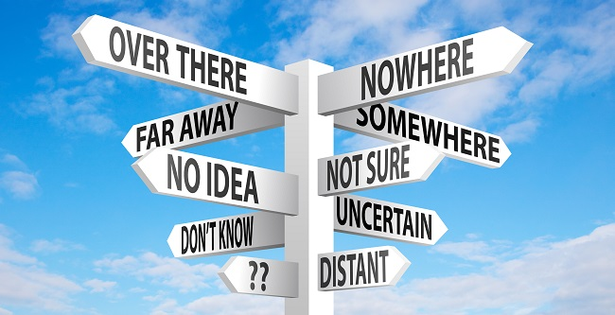

Slide 13
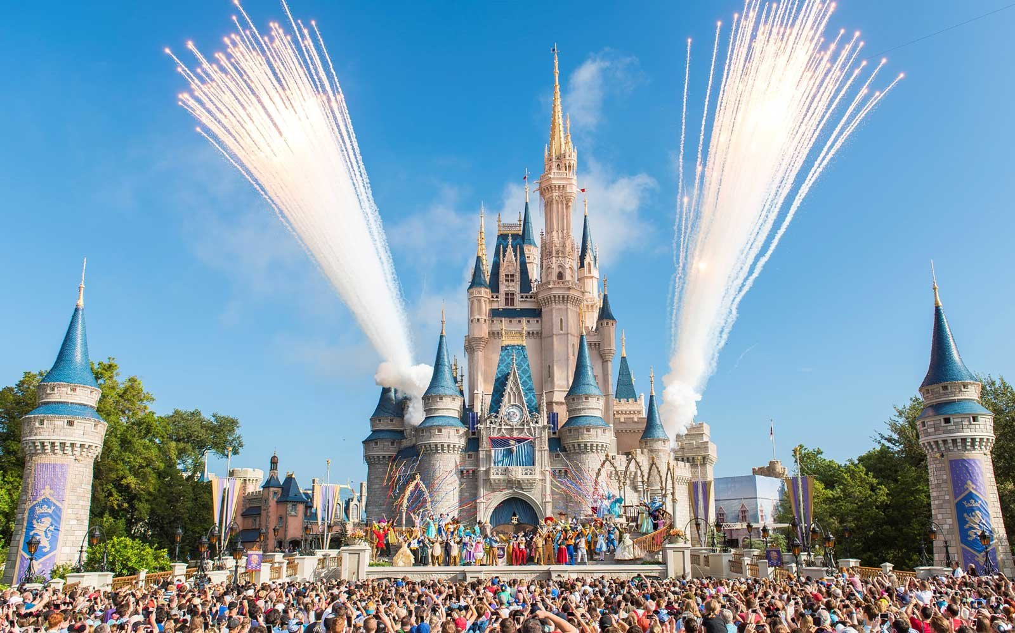

Slide 14
Geography Review

Slide 15
Geography Skills Test
If you get an 80% or higher, you passed!
Remember this is a test, so it must be silent for the ENTIRE TEST!!!

